Slide 1

Blessed Saints within the Vineyard
Chapter 16:17 – 27
17 November 2021
Week 34

Slide 2

Romans 16:17 – 27
Overview . . .
A final warning is given against those who would cause divisions and occasions of stumbling contrary to what Paul had taught in this epistle (17-18). For above all else, Paul wanted to ensure their continued obedience in the gospel (19-20).
Paul’s companions at Corinth add their greetings (21-24), and Paul closes this wonderful epistle with an expression of praise to God for the revelation of the gospel which was leading to the obedience of faith among all nations (25-27).

Slide 3

Tonight’s focus . . .
“Blessed Saints within the Vineyard”

Slide 4
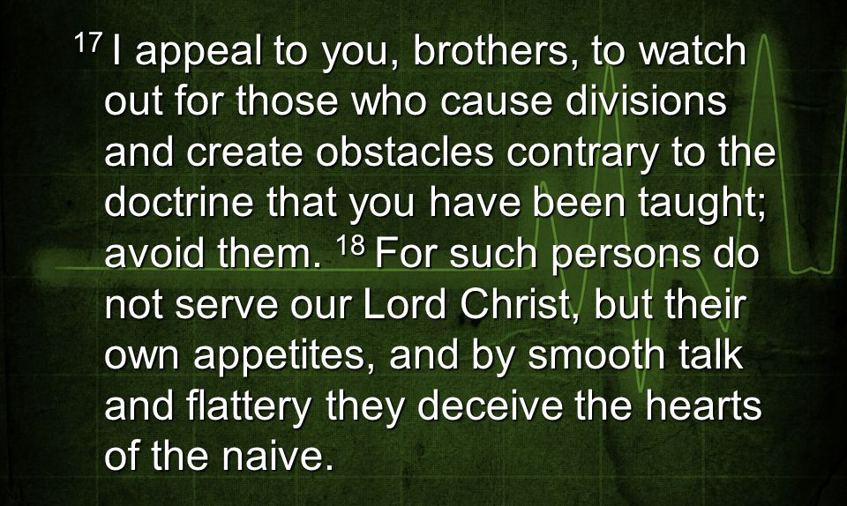
Romans 16:17 – 18

Slide 5
Romans 16:17 – 18
To prepare the Roman believers, Paul taught them how to detect the presence of “trouble makers” (17), and revealed their quintessential character traits (18).
Paul “urges” (appeals) the Romans only two other times in his letter. He urges them to present themselves as living sacrifices (12:1), and he urges them to pray that his plans for Spain would not be hindered (15:30).
In this case, Paul urges the congregation to keep an “eye out” (scope) for divisive behavior.

Slide 6
Romans 16:17 – 18
The whole congregation—not just its leaders—was to “watch out” for people who created two deadly dangers: “dissension” and “hindrances.”
Swindoll: some people have the uncanny ability to split a group into two factions and have them arguing in no time. However, divisive people are very difficult to identify because they are masters of stealth.
Whispering and private one-on-one meetings are the tools of their trade. And, worst of all, they don’t even recognize themselves as dividers of people.

Slide 7
Romans 16:17 – 18
They’re just “trying to help” by offering advice wherever they can. The best way to identify a creator of dissension is to take note of drama and then listen to the conversations that surround it.
Before long, a name will surface in one incident that’s common to the others. Dividers are rarely satisfied with only one schism.
Another indication of a “divisive person” is the development of “hindrance.” These people set theological traps that bait unwary Christians.

Slide 8
Romans 16:17 – 18
Their teaching is attractive yet contrary to the truth taught by Jesus and the people He personally trained.
Today we have this truth inerrantly preserved for us in Scripture. Therefore, a “hindrance” is any doctrine or practice that Scripture does not support.
Having identified the telltale signs that an intruder has entered the church, Paul exposed his or her true nature. Such people do not serve Christ, because they are slaves to their own appetites (bellies).

Slide 9
Romans 16:17 – 18
Their teaching—along with every other activity—benefits them personally. The payoff may be money, power, prestige, control, sympathy—anything that depravity craves.
And to conceal their true intentions, they project a remarkably admirable image. They have mastered church vocabulary—a dialect call “Christianese”—and have perfected the demeanor of a mature believer.

Slide 10
Romans 16:17 – 18
Divisive people and false teachers keep their people skills polished to a high gloss. They instinctively find trusting people in positions of influence and then play to their weaknesses.
If it’s pride, they flatter. If it’s fear, they reinforce their sense of control. If it’s insecurity, they make them feel important. If it’s despair, they promise the impossible.
Because the truth is often uncomfortable to hear, they avoid saying anything resembling the truth. And so the unwary are led away. By the time the lies are finally exposed, the loss is incalculable.

Slide 11
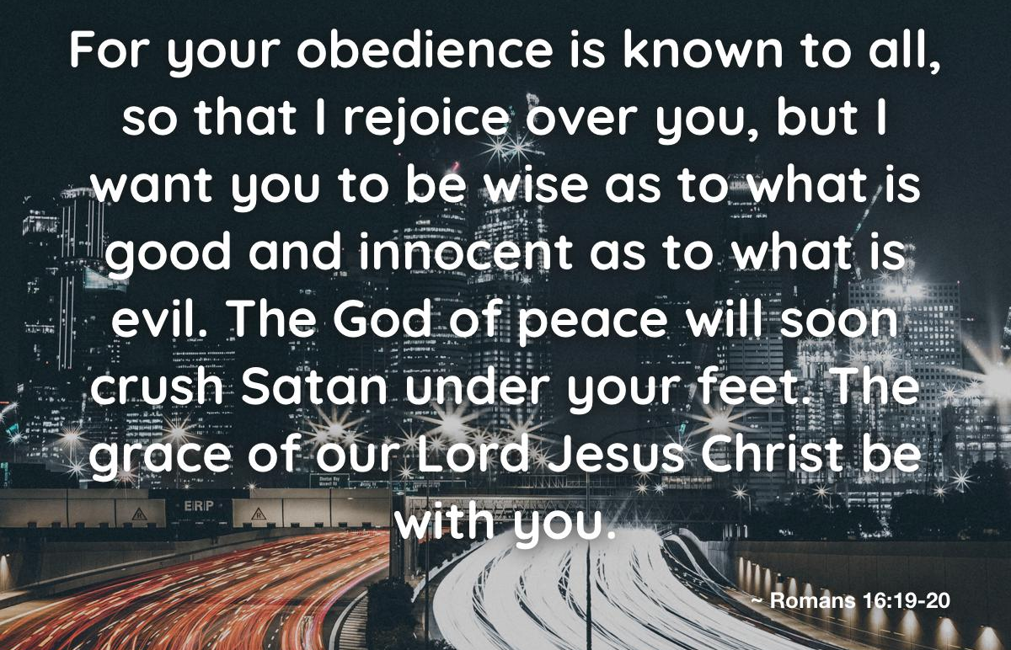
Romans 16:19 – 20

Slide 12
Romans 16:19 – 20
Fortunately, the congregation was strong, so Paul’s instruction on how to defend God’s vineyard was brief and mostly took the form of affirmation (19-20). Paul’s advice is succinct, which makes it especially valuable.
Paul’s letter is addressed to the congregation at large; therefore, his counsel concerning “church discipline” is different. The primary responsibility of any congregation is obedience to the truths of Scripture. And in this regard, the Romans had earned an exemplary reputation among other churches.

Slide 13
Romans 16:19 – 20
Take note of this specific advice. They were to be “wise in what is good,” meaning that knowledge and behavior were to be in agreement. If you really believe something is true, your choices should adjust accordingly.
In fact, Paul noted to his colleague Titus that the invariable characteristic of a false teachers is their failure to obey the Scripture: Tit. 1:15-16 > “This is a faithful saying, and worthy of all acceptation, that Christ Jesus came into the world to save sinners; of whom I am chief. ¹⁶Howbeit for this cause I obtained mercy, that in me first Jesus Christ might show forth all longsuffering, for a pattern to them which should hereafter believe on him to life everlasting.”

Slide 14
Romans 16:19 – 20
Additionally, the congregation was to be “innocent in what is evil.” The word “innocent” can also describe city walls that had survived a siege. Intact or unscathed would be accurate synonyms.
Evil will certainly attack, and its assault will be intense; however, the walls of the congregation’s integrity must hold. While the leaders have a responsibility to confront divisive people and false teachers, the congregation does not. Wisdom and vigilance are all the church needs.

Slide 15
Romans 16:19 – 20
A wise and wary congregation knows when the people have been divided and quickly recognizes the tactics of those who thrive on dissension.
Then, the members can simply refuse to be divided or misled. Divisive people tend to move on when they lose their audience.
Because the church in Rome had always been strong in this regard, Paul assures them that God would soon defeat Satan, and that God’s means would be the feet of His faithful followers.

Slide 16
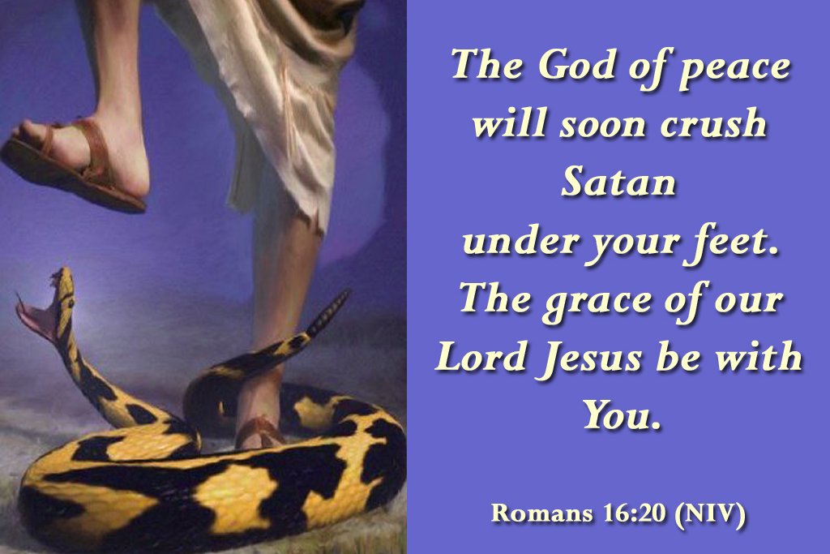
Romans 16:19 – 20

Slide 17
Romans 16:21 – 22
²¹Timothy, my fellow worker, and Lucius, Jason, and Sosipater, my countrymen, greet you. ²²I, Tertius, who wrote this epistle, greet you in the Lord.

Slide 18
Romans 16:21 – 22
The apostle Paul was willing to stand alone for the truth if necessary, but he was anything but independent or aloof. He usually traveled with an entourage that grew over time.
At the time of writing Romans, Paul had no fewer than five serious ministers-in-training with him in Corinth and several others out on assignment (Silas, Luke, and Titus, to name a few).
When forced to travel ahead, he always waited for his group (Acts 17:16; 18:5), and when left alone during his second Roman imprisonment, he longed for companionship (2Tim 4:9-11).

Slide 19
Romans 16:21 – 22
Paul loved the people who labored alongside him. In fact, he depended upon them. Having grown emotionally attached to his friends, his joy was diminished when they were not near.
This is as it should be. God did not create us to be alone or aloof. That’s not to say we should be incapable of solitude; when left alone, Paul made good use of his time.
But collaboration fueled his enthusiasm and enlarged his ministry. Paul clearly preferred the company of others.

Slide 20
Romans 16:21 – 22
After greeting a list of people in Rome whom he anticipated seeing (16:16) and commending their internal strength (16:17-20), the apostle sent greetings from some of his top aides and closest friends.
Paul first met Timothy when visiting the towns of Lystra and Derbe (Acts 16:1-2). Timothy impressed Paul so much that the apostle invited him to join the mission.
By the time Paul completed this letter, Timothy had become one of his closest friends and was among his most capable assistants.

Slide 21
Romans 16:21 – 22
Paul also names three other men who had joined the growing band of ministers. Lucius was probably one of the “prophets and teachers” ministering in Antioch who heard God’s instructions to send our Paul and Barnabas (Acts 13:1).
Paul first met Jason in Thessalonica, where he witnessed his bravery firsthand (Acts 17:5-9). And Sosipater joined the group when Paul ministered in Berea (Acts 20:4, where he is called Sopater). Appropriately, Paul calls them “kinsmen,” a term he reserved for Jews (16:7, 11).

Slide 22
Romans 16:21 – 22
Paul permits his “amanuensis,” Tertius, to include his own greeting. It was very common practice for Paul to have one of his assistants write out his thoughts for him.
They had heard their mentor speak on a given subject dozens of times and could prepare a faithful draft with a little direction. Then, after a thorough edit by the apostle himself, his amanuensis would prepare the final draft using his best penmanship.
Paul frequently added his own person touch near the end: 1Cor16:21; Gal 6:11; Col 4:18; Phlm 1:19.

Slide 23
Romans 16:21 – 22
The amanuensis was not a “ghostwriter.” All of the epistle of Paul were one hundred percent Paul’s. He supervised, reviewed, and approved the actual wording, and he signed the document as his own.
In time-honored tradition, he charged a trusted assistant with the task of penning the final product. And in this case, the amanuensis was named Tertius, which means “third.” His was a common name for a slave.

Slide 24
Romans 16:23 – 24
²³Gaius, my host and the host of the whole church, greets you. Erastus, the treasurer of the city, greets you, and Quartus, a brother. ²⁴The grace of our Lord Jesus Christ be with you all. Amen.

Slide 25
Romans 16:23 – 24
During Paul’s three months in Greece (Acts 20), he most likely was hosted by none other than a wealthy convert named Gaius, whom Paul personally baptized (1Cor 1:14).
Erastus was “the city treasurer,” most likely of Corinth. City managers were often freed slaves who had attained a fair measure of wealth. His name means “beloved” and was a common choice of freed slaves who no longer wanted to be identified as merely a number.
It is not likely that this Erastus and Gaius were the same men as those who traveled with Paul.

Slide 26
Romans 16:23 – 24
Quartus means “fourth.” Like Tertius, he was probably a slave. Because he is grouped with Gaius and Erastus, we can assume he lived in Corinth and may have seven served in the household of Paul’s host.
Quartus must have brimmed with joy when Paul called him “brother.”
While a majority of later manuscripts include the words of 16:24, it is relocated to 16:27 in some and missing entirely from the very oldest copies of the letter to the Romans. Therefore, it is likely a later addition.

Slide 27
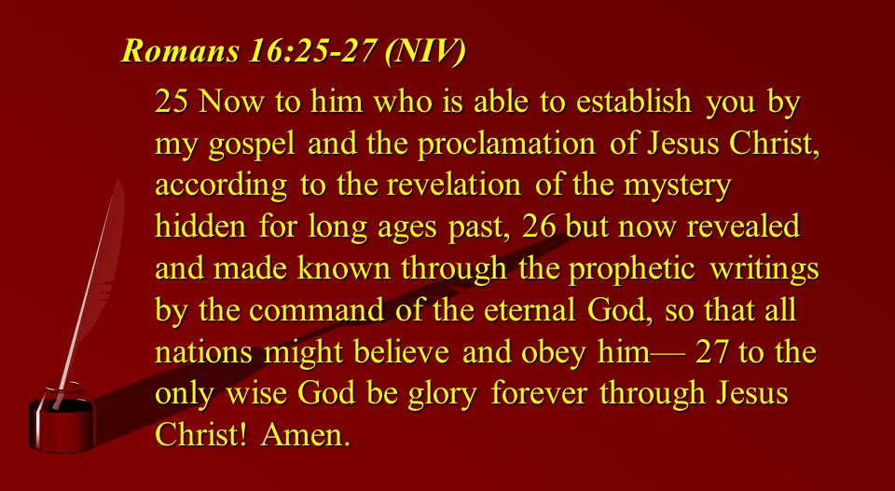
Romans 16:25 – 27

Slide 28
Romans 16:25 – 27
The final section of the final chapter offers a benediction that praises the majesty of God. As Paul prepares to close, he set aside his arguments, he pushes doctrine to the background, he turns his thoughts away from people, and he gives full attention to the glory of God.
These three verses form one long sentence composed of several compound phrases, much like his opening line (1:1-7). The basic sense is, “Now to Him who is able to establish you . . . Be the glory forever.”

Slide 29
Romans 16:25 – 27
But the words and phrases in between were anything but haphazard. Paul carefully chose each one to reflect the message of his letter and to ascribe them to the authorship of God.
“Now to Him who is able to establish you” identifies God as the sole source of stability and strength for the believer. While we are encouraged to engage in the Holy Spirit’s transforming work, we cannot transform ourselves.
The Lord alone is able to do this.

Slide 30
Romans 16:25 – 27
“According with my gospel and the message I proclaim about Jesus Christ.” The Lord establishes us in keeping with the promises of the gospel. Paul calls the good news “my gospel,” not to claim authorship, but to claim ownership.
The gospel belonged to him because he staked his own soul upon its truth. And the gospel was his to steward in keeping with God’s calling.
Moreover, the good news of God’s grace and His salvation through faith is centered on the person of Jesus Christ and no one else.

Slide 31
Romans 16:25 – 27
“In keeping with the revelation of the mystery hidden for long ages past.” A mystery (secret) is a divine truth that was once concealed but now revealed.
The complete truth of Jesus Christ was not fully known until He rose from the dead and ascended to heaven.
Now it has been revealed in full: Christ died for our sins according to the Scriptures, and He was buried. He paid the complete penalty for our sins on the cross, and nothing else is needed to satisfy God’s requirement for justice.

Slide 32
Romans 16:25 – 27
Christ was miraculously and bodily raised from the dead to new life. He now offers that same eternal life to all who would receive it by grace through faith in Him.
Those who receive God’s free gift of eternal life will be raised to new life after death to be with Him forever.
Those who reject this gift will spend eternity in torment.

Slide 33
Romans 16:25 – 27
“But now revealed.” What is so simple, clear, and available now was unknown for many centuries before Christ revealed it. Paul counted it his privilege to proclaim this mystery now unveiled.
“And made known through the prophetic writings by the command of the eternal God, so that all the Gentiles.” The gospel has always been a part of God’s plan and can be traced through the Scriptures all the way back to Moses. The message entrusted to the Jews has been revealed in full and made available to every race, culture, nation, and generation. How gracious of our God!

Slide 34
Romans 16:25 – 27
“Might come to the obedience that comes from faith.” With this phrase, the apostle brought his letter—and the gospel—full circle. Both have the “righteousness of God” as their ultimate end.
The gospel has not achieved its complete purpose until those who believe and all of creation exist in harmony with the goodness of God—as it was in the beginning.

Slide 35
Romans 16:25 – 27
“To the only wise God be glory forever through Jesus Christ.” The Lord created the world, filled it, organized it, and gave everything purpose. He then created humanity in His own image, and placed them in the world to live and enjoy its abundance.
And He gave them a singular purpose: “to glorify God, and fully to enjoy him forever.” Jesus Christ made this possible, and He will consummate the restoration of all things to again reflect the glory of God. And to this, I join Paul in declaring a passionate amen!

Slide 36
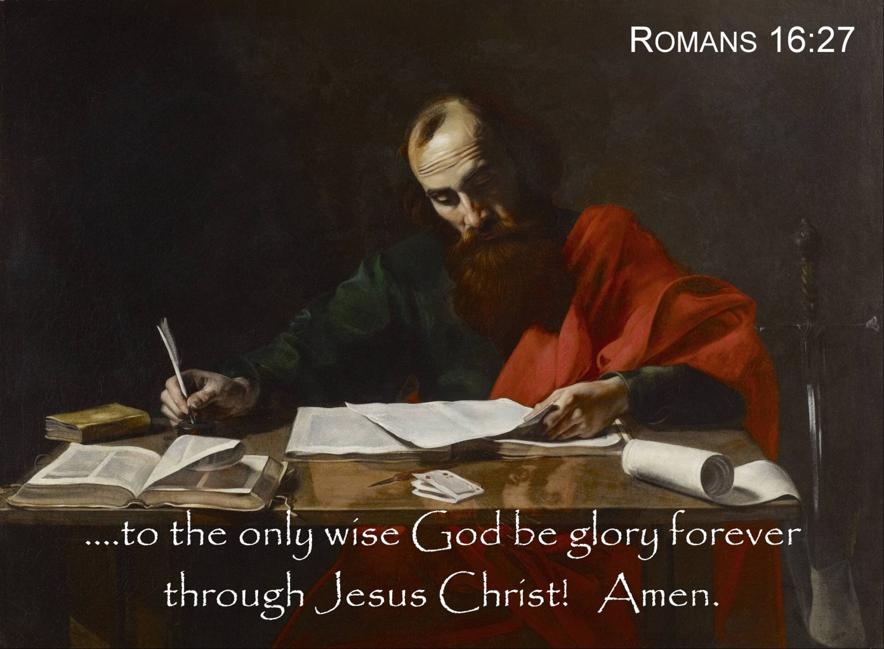

Slide 37
Letter to the Romans
Who: Paul
What: Letter to Roman Christians
Where: Corinth
When: c. ad 57
Why: To illustrate law, faith, salvation, and righteous living.
Synopsis: Jesus is God’s Son, a suffering servant of all people.

Slide 38
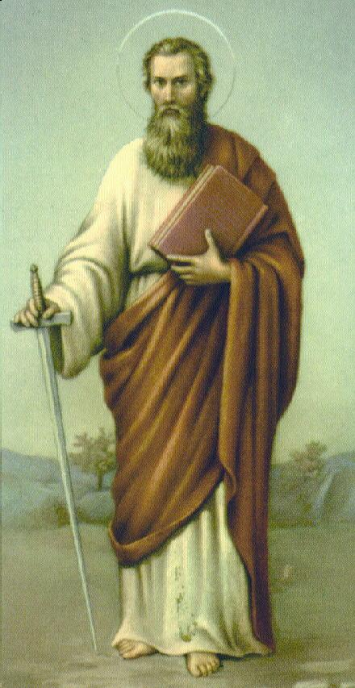
Letter to the Romans
Outline (Chapter):
God’s righteousness and salvation: Christian Gospel: (doctrinal) (1 – 8)
God’s righteousness and Israel: (historical) (9 – 11)
God’s righteousness and application: Christian Life (practical) (12 – 16)
Apostle Paul

Slide 39
Letter to the Romans
Check out an overview video on YouTube on the Book of Romans (in two parts) at:
Chapters 1 – 4 > https://youtu.be/ej_6dVdJSIU
Chapters 5 -16 > https://youtu.be/0SVTl4Xa5fY

Slide 40

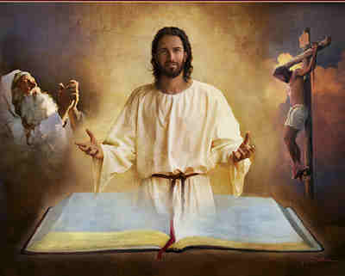
Welcome … Ye blessed saints of the Vineyard

